Slide 1
John 3 Rod Thom

Slide 2
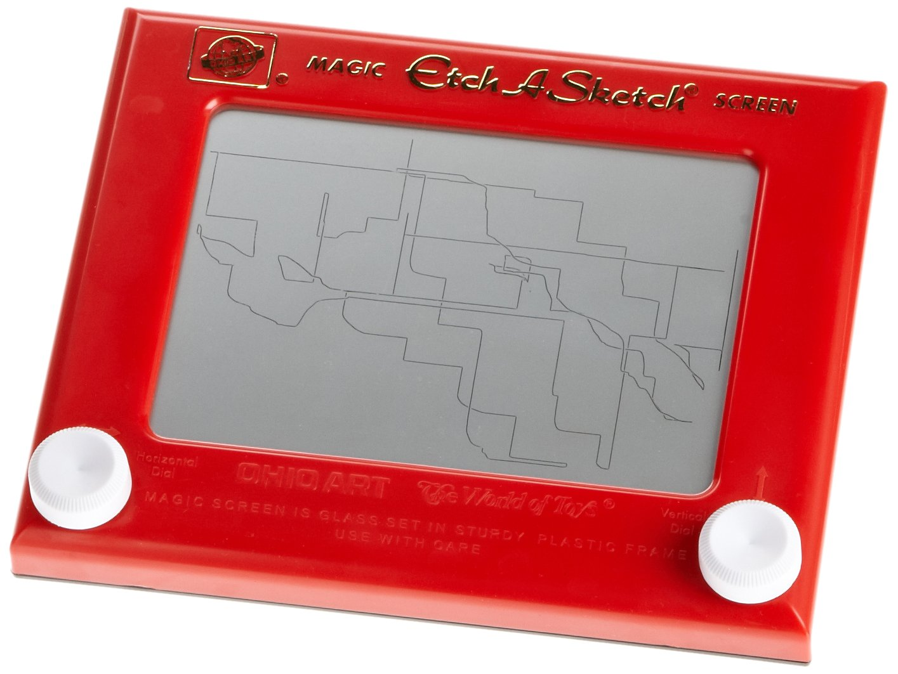

Slide 4
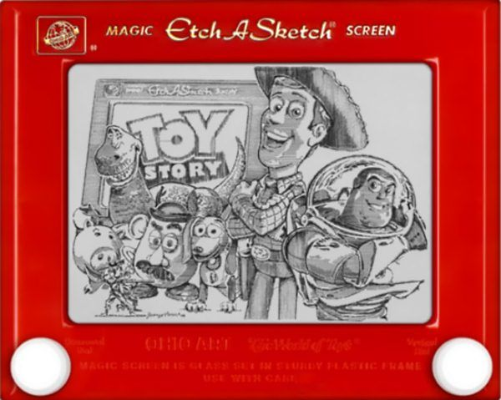

Slide 5
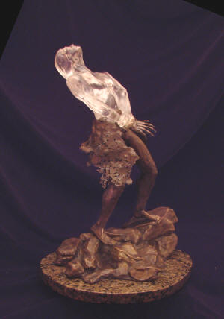
“I Tell You the Truth!”
“It doesn’t matter who you are or what you have done, you must be born again!

Slide 6
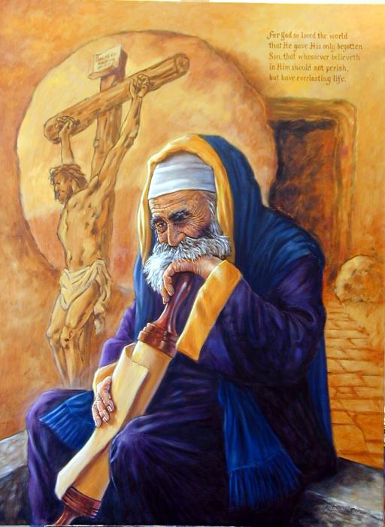
“I Tell You the Truth!”
John 3:1 Now there was a Pharisee, a man named Nicodemus who was a member of the Jewish ruling council.

Slide 7
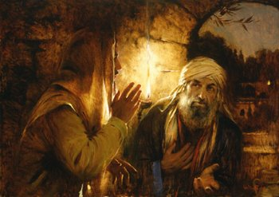
“I Tell You the Truth!”
2 He came to Jesus at night

Slide 8
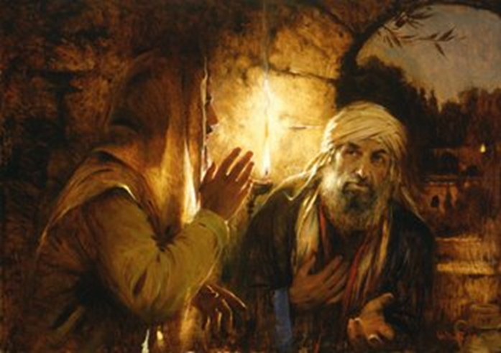
“I Tell You the Truth!”
V2 cont… and said, “Rabbi, we know that you are a teacher who has come from God. For no one could perform the signs you are doing if God were not with him.”

Slide 9
“I Tell You the Truth!”
V3 Jesus replied, “Very truly I tell you,
no one can see the kingdom of God unless they are born again.”
4 “How can someone be born when they are old?” Nicodemus asked. “Surely they cannot enter a second time into their mother’s womb to be born!”

Slide 10
“I Tell You the Truth!”
5 Jesus answered, “Very truly I tell you, no one can enter the kingdom of God unless they are born of water and the Spirit. 6 Flesh gives birth to flesh, but the Spirit gives birth to spirit. 7 You should not be surprised at my saying, ‘You must be born again.’ 8 The wind blows wherever it pleases. You hear its sound, but you cannot tell where it comes from or where it is going. So it is with everyone born of the Spirit.”

Slide 11
“I Tell You the Truth!”
9 “How can this be?” Nicodemus asked.
10 “You are Israel’s teacher,” said Jesus, “and do you not understand these things? 11 Very truly I tell you, we speak of what we know, and we testify to what we have seen, but still you people do not accept our testimony. 12 I have spoken to you of earthly things and you do not believe; how then will you believe if I speak of heavenly things?

Slide 12
“I Tell You the Truth!”
13 No one has ever gone into heaven except the one who came from heaven—the Son of Man. 14 Just as Moses lifted up the snake in the wilderness, so the Son of Man must be lifted up, 15 that everyone who believes may have eternal life in him.”

Slide 13
“I Tell You the Truth!”
Numbers 21:4 They traveled from Mount Hor along the route to the Red Sea,[c] to go around Edom. But the people grew impatient on the way; 5 they spoke against God and against Moses, and said, “Why have you brought us up out of Egypt to die in the wilderness? There is no bread! There is no water! And we detest this miserable food!”

Slide 14
“I Tell You the Truth!”
6 Then the Lord sent venomous snakes among them; they bit the people and many Israelites died. 7 The people came to Moses and said, “We sinned when we spoke against the Lord and against you. Pray that the Lord will take the snakes away from us.” So Moses prayed for the people.
8 The Lord said to Moses, “Make a snake and put it up on a pole; anyone who is bitten can look at it and live.” 9 So Moses made a bronze snake and put it up on a pole. Then when anyone was bitten by a snake and looked at the bronze snake, they lived.

Slide 15
“I Tell You the Truth!”
16 For God so loved the world that he gave his one and only Son, that whoever believes in him shall not perish but have eternal life. 17 For God did not send his Son into the world to condemn the world, but to save the world through him. 18 Whoever believes in him is not condemned, but whoever does not believe stands condemned already because they have not believed in the name of God’s one and only Son.

Slide 16
“I Tell You the Truth!”
“It doesn’t matter who you are or what you have done, you must be born again!

